Slide 1
National Voter.
Registration Day.
Save the Date: Tuesday, September 17.

Slide 2
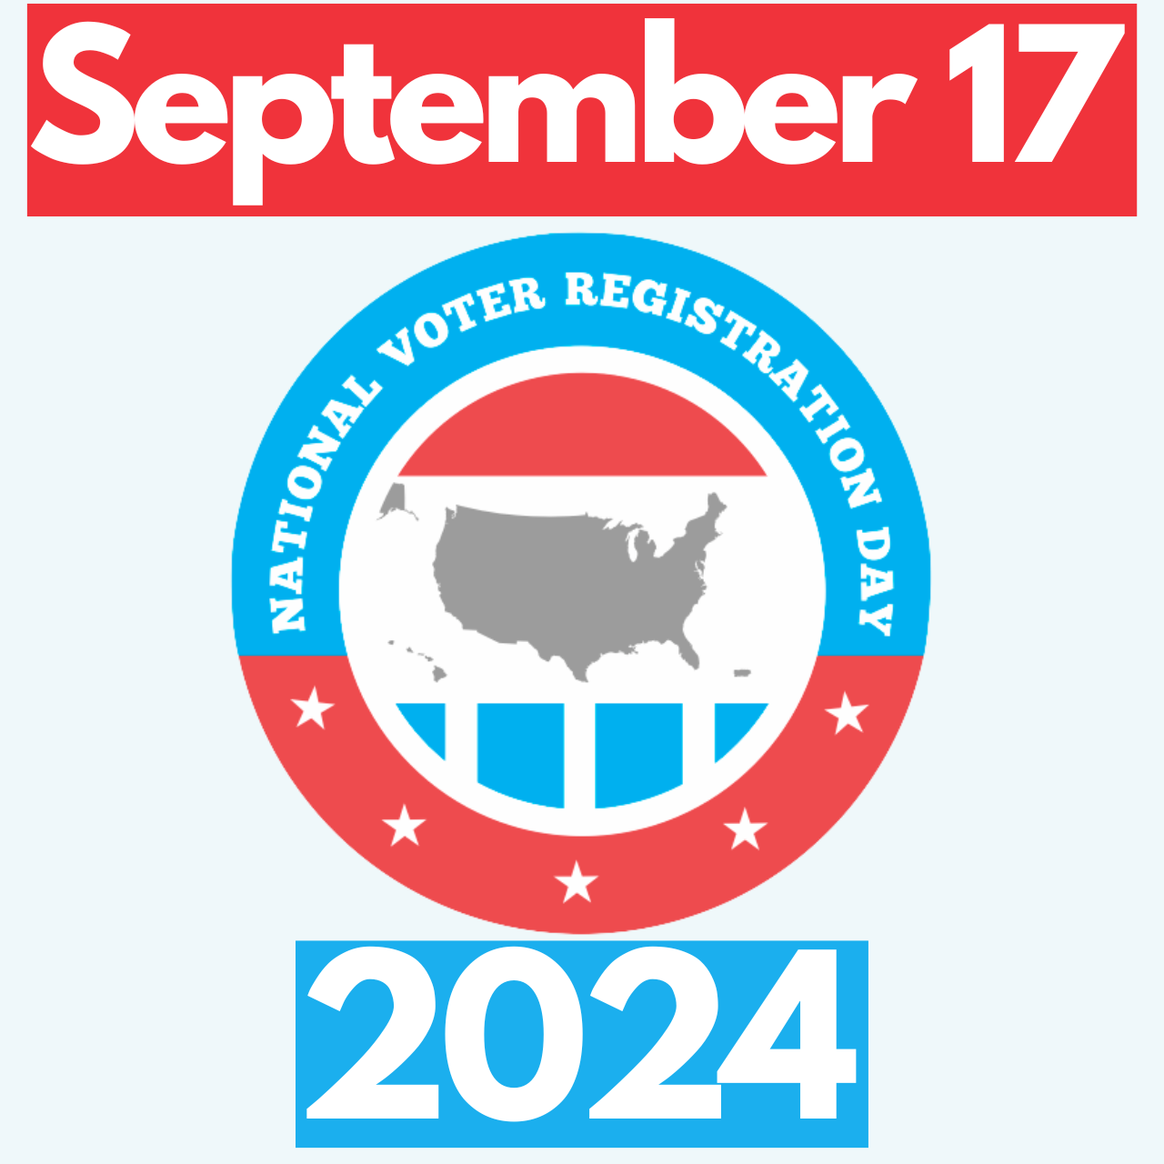
What is National Voter Registration Day?
Nonpartisan civic holiday to get Americans registered and #VoteReady
Held each year on a Tuesday of September, with this year on September 17, 2024
Coordinated day of events to share registration opportunities before state deadlines
Notes:
“Are you part of our story?”
If you have checked your voter registration in the last year, rub your hands together.
If you have ever helped someone else register to vote, do a drumroll.
If you have participated in NVRD as a community partner, clap your hands.
Now if you made any noise, make it again now, all together. That’s the sound of democracy at work.

Slide 3
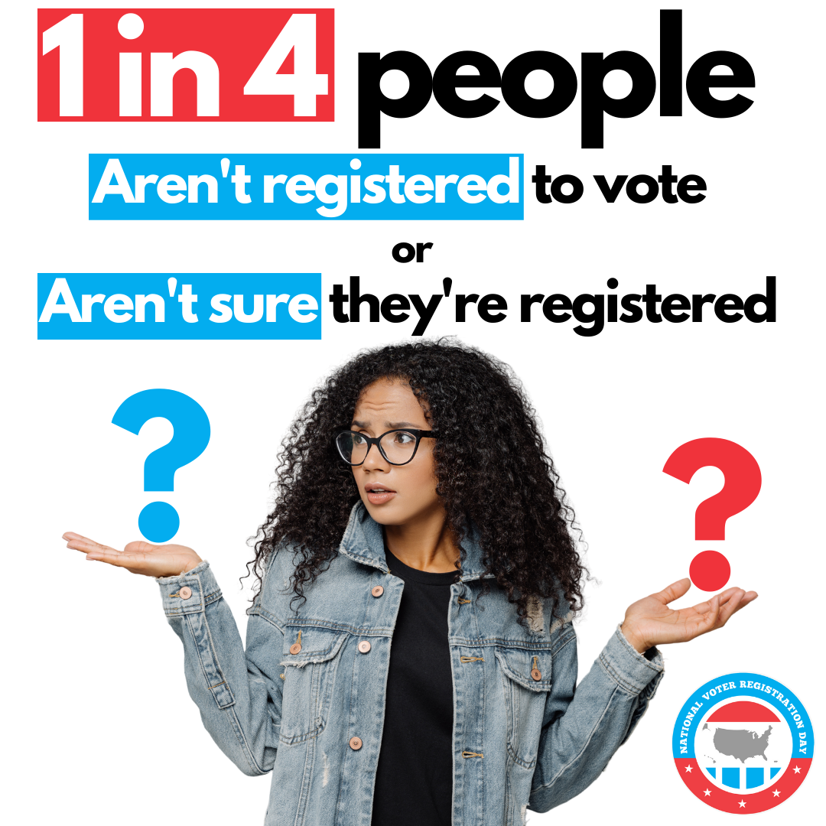
Why celebrate National Voter Registration Day?
As many as 1 in 4 eligible Americans are NOT registered to vote
This figure is EVEN higher for youth and communities of color
Millions of Americans miss elections each year due to registration problems or missing deadlines
Our democracy works best when more of us participate!
YOU have unique & trusted relationships in your community, & YOU can help change this!

Slide 4
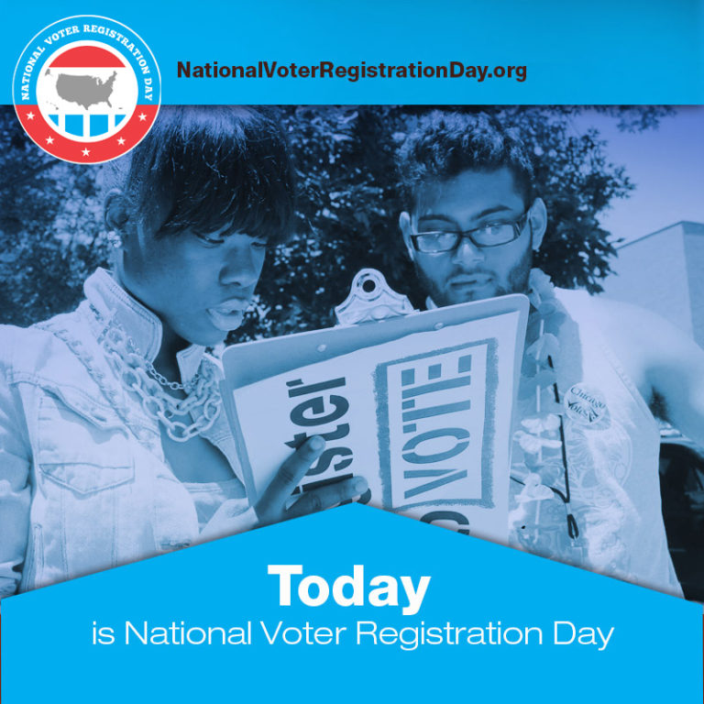
5.5 Million registered and counting!
Since 2012, National Voter Registration Day has helped more than 5 million people register to vote for the first time or update their registration.

Slide 5
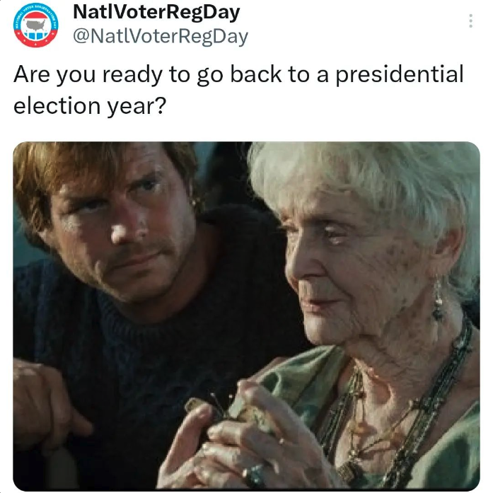
We have big goals for 2024
Register more than 750,000 people to vote on September 17
Engage more than 4,500 Community Partners (like you)
Get America vote ready for 2024’s MASSIVE election year!

Slide 6
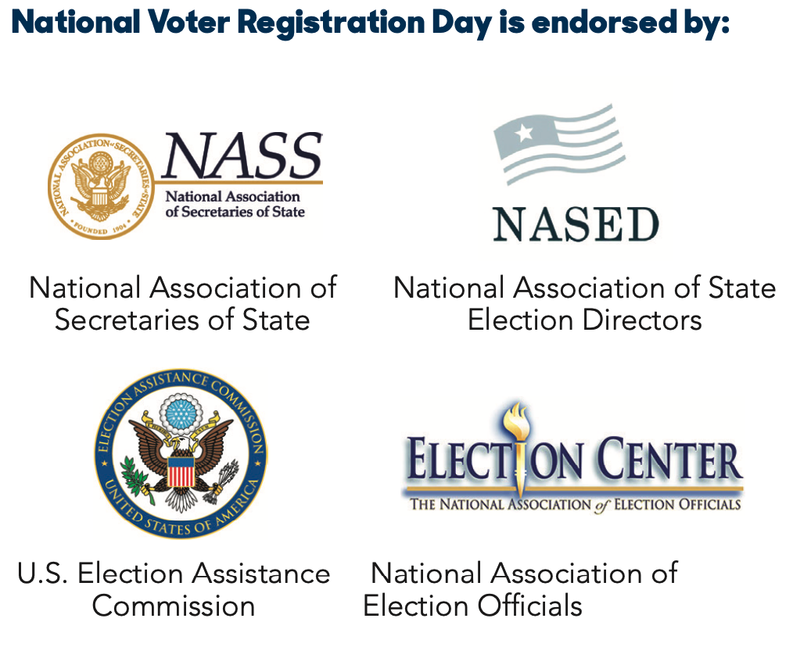
You are part of something BIG
Supporting hundreds of thousand of voters nationwide as they …
Update their registration or register to vote for the first time
Learn more about upcoming elections
Celebrate a civic holiday!
Joined by thousands of community partners across the country!

Slide 7
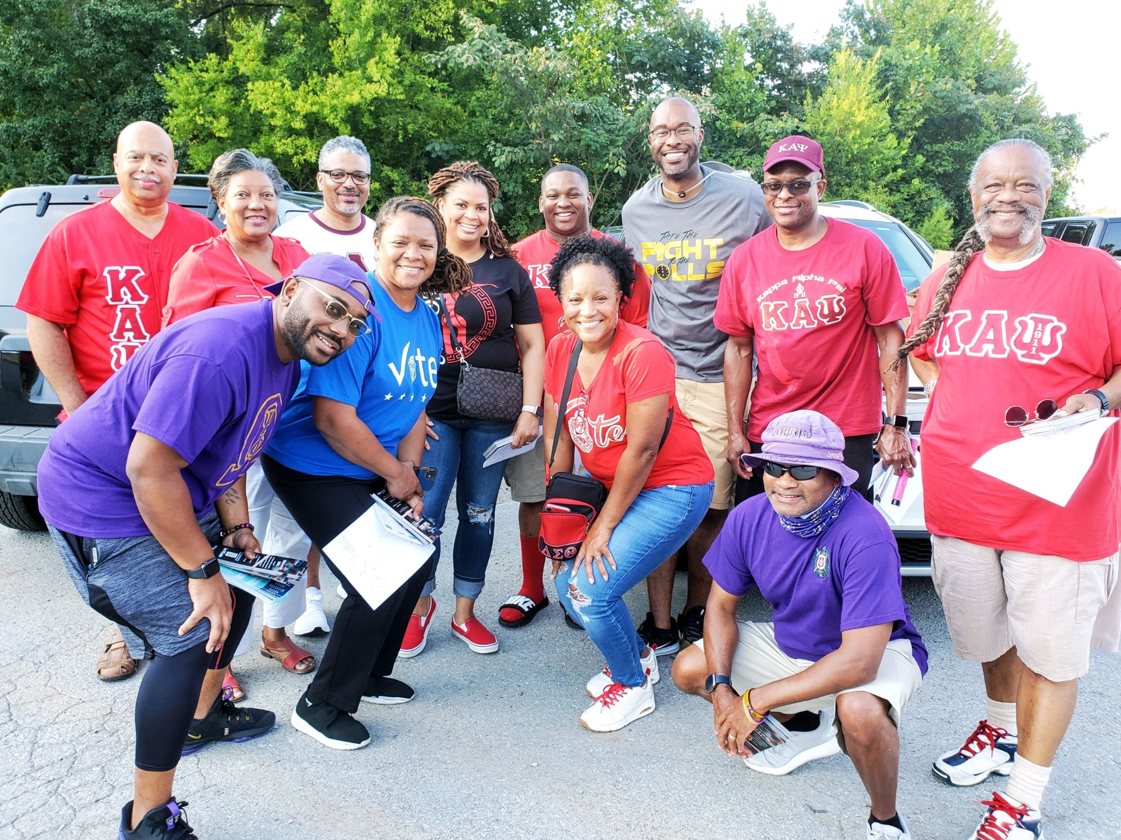
Why become a partner?
National Voter Registration Day is a partner-driven effort!
Every year, thousands of partners of all stripes and sizes participate: nonprofits, campus and youth groups, high schools, libraries, election offices, companies, co-ops, digital platforms, media outlets, and more
Partners organize community events, post on social media, conduct employee outreach, hold online events, and leverage their network and reach to register voters

Slide 8
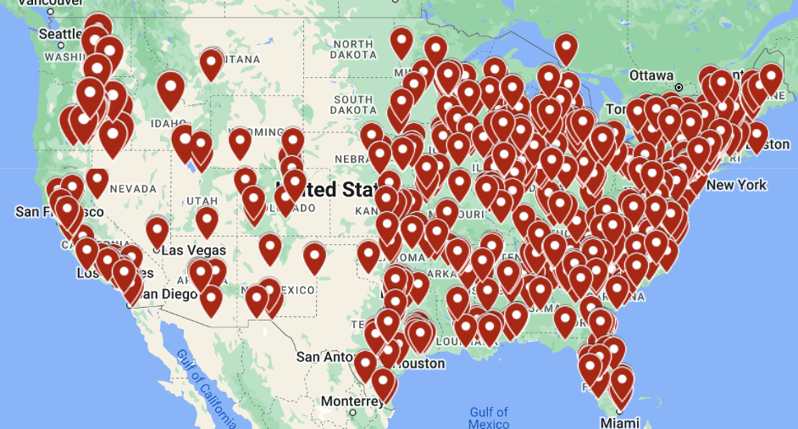
Thousands of partners already signed on all across America!
…and the number keeps growing!

Slide 9
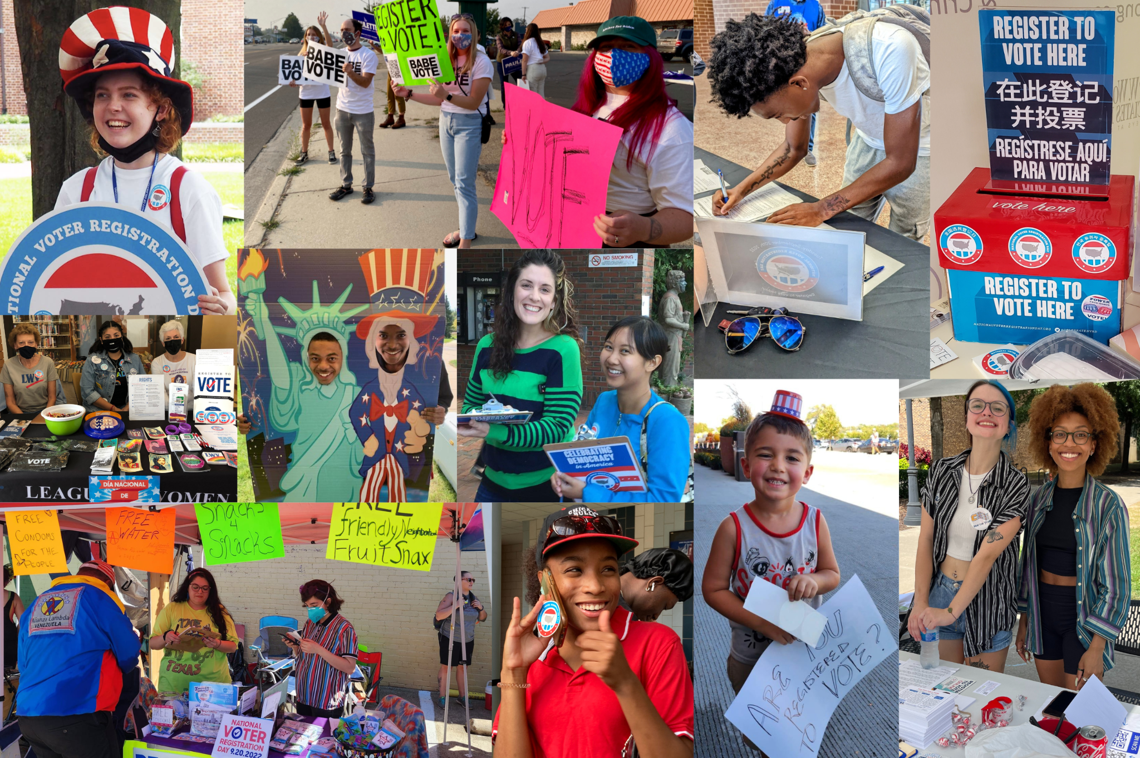
Community partner expectations
Nonpartisan
Inclusive
Aware of your state’s voter registration laws
Non-transactional
Fun!

Slide 10
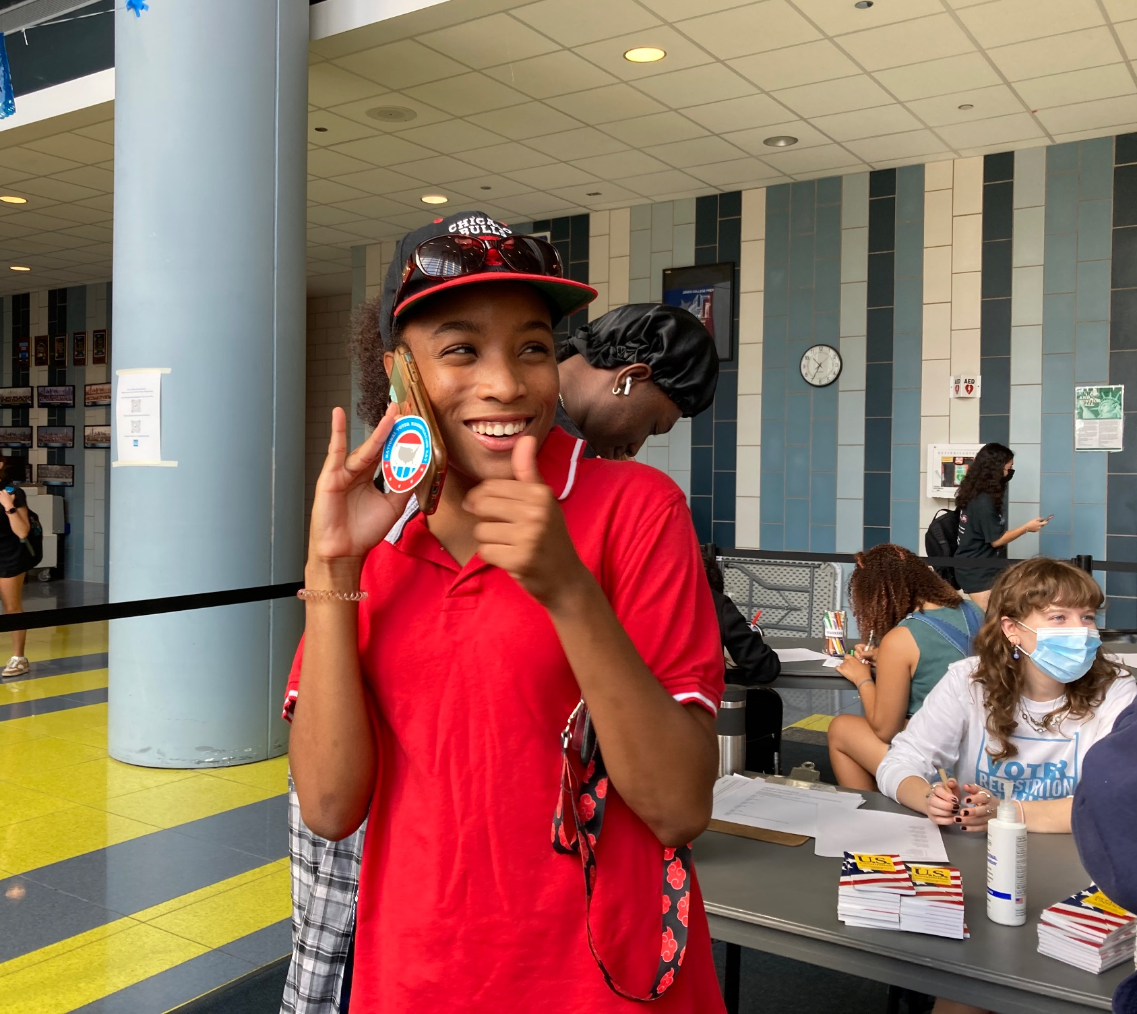
How we support you
We support partners of ALL experience levels to succeed. 30% of partners each year are completely NEW to voter registration!
Free swag, including branded posters and stickers, and QR code registration placards
Communications and social media support
Live training webinars
State-specific resources
Organizer guides
Publicly uplifting your work

Slide 11
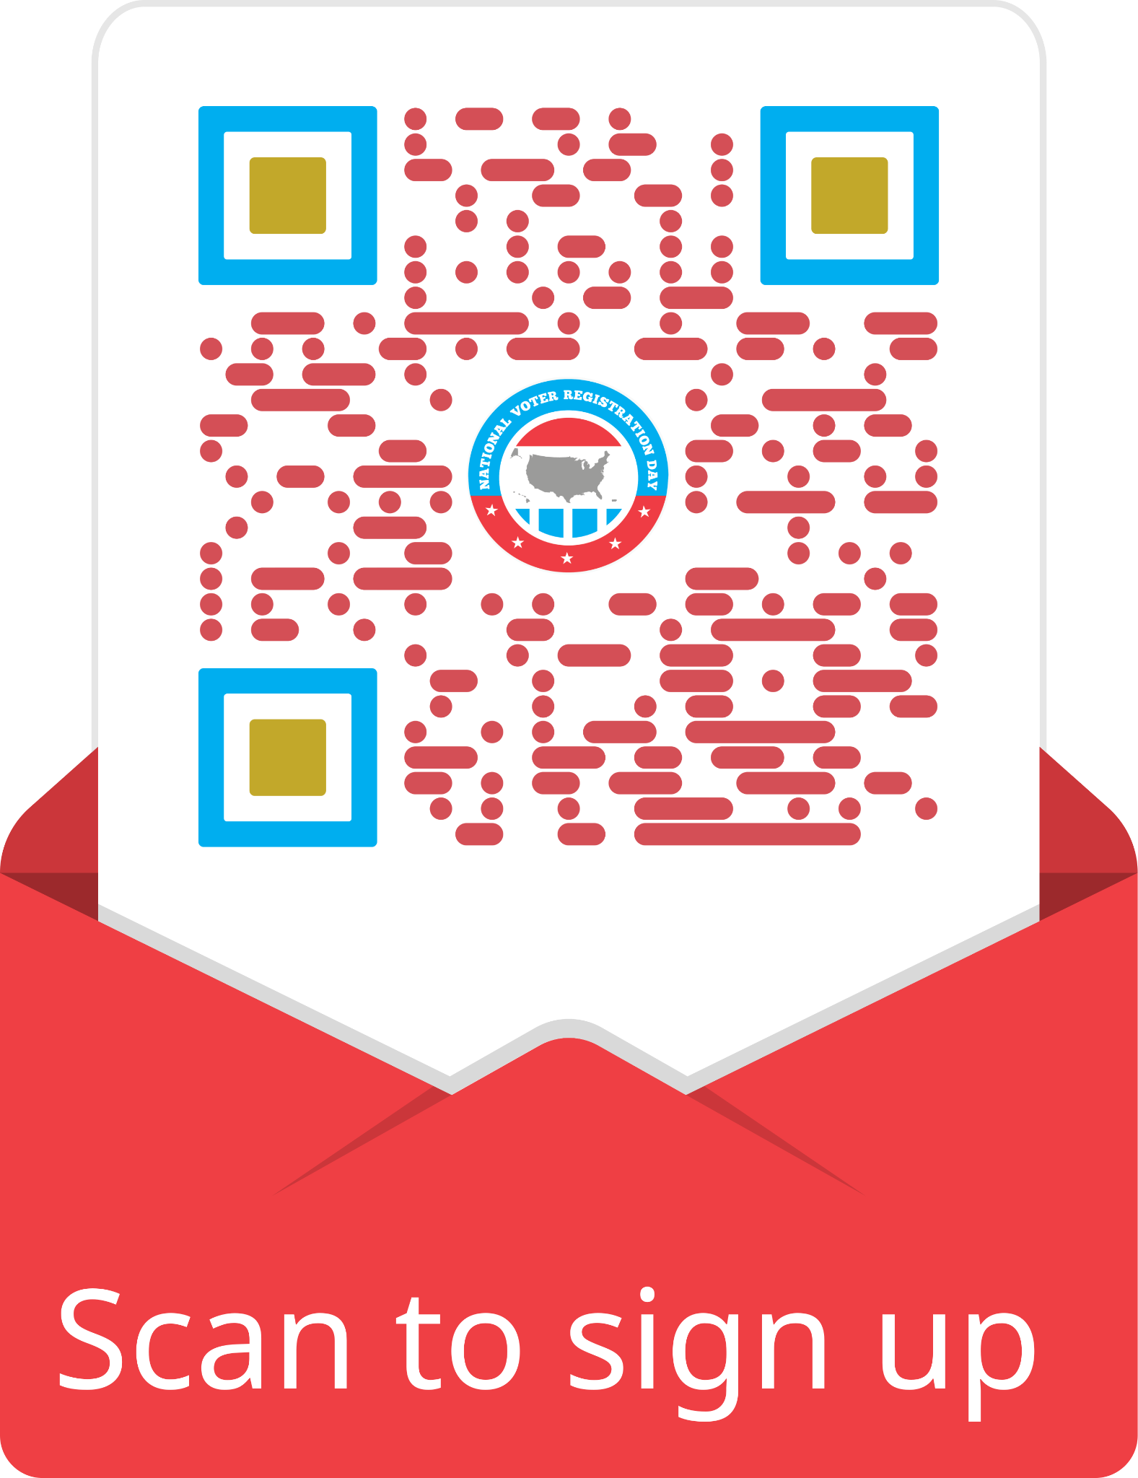
Become a 2024 partner TODAY!
Partners agree to remain nonpartisan in all outreach associated with the holiday
With YOUR help, we hope to register hundreds of thousands of voters in time to participate in the 2024 elections!
Follow along on social: @NatlVoterRegDay on all platforms
Scan QR code to sign up in just 5 minutes or less!

Slide 12
See you on September 17!
National Voter Registration Day 2024

