Slide 1
National Voter Registration Day Tuesday, September 19, 2023

Slide 2
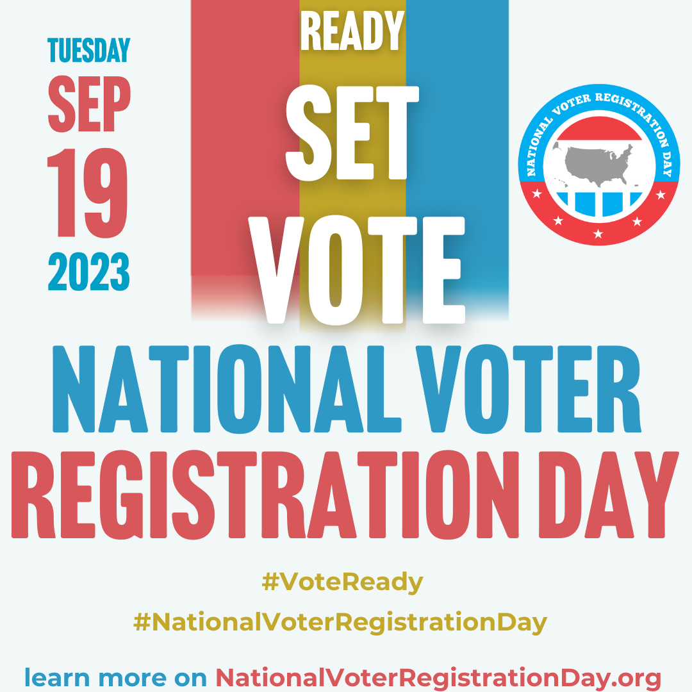
What is National Voter Registration Day?
Nonpartisan civic holiday to get Americans registered and #VoteReady
Held each year on a Tuesday of September, with the next one on September 19, 2023
Coordinated day of events to share registration opportunities before state deadlines
Notes:
“Are you part of our story?”
If you have checked your voter registration in the last year, rub your hands together.
If you have ever helped someone else register to vote, do a drumroll.
If you have participated in NVRD as a community partner, clap your hands.
Now if you made any noise, make it again now, all together. That’s the sound of democracy at work.

Slide 3
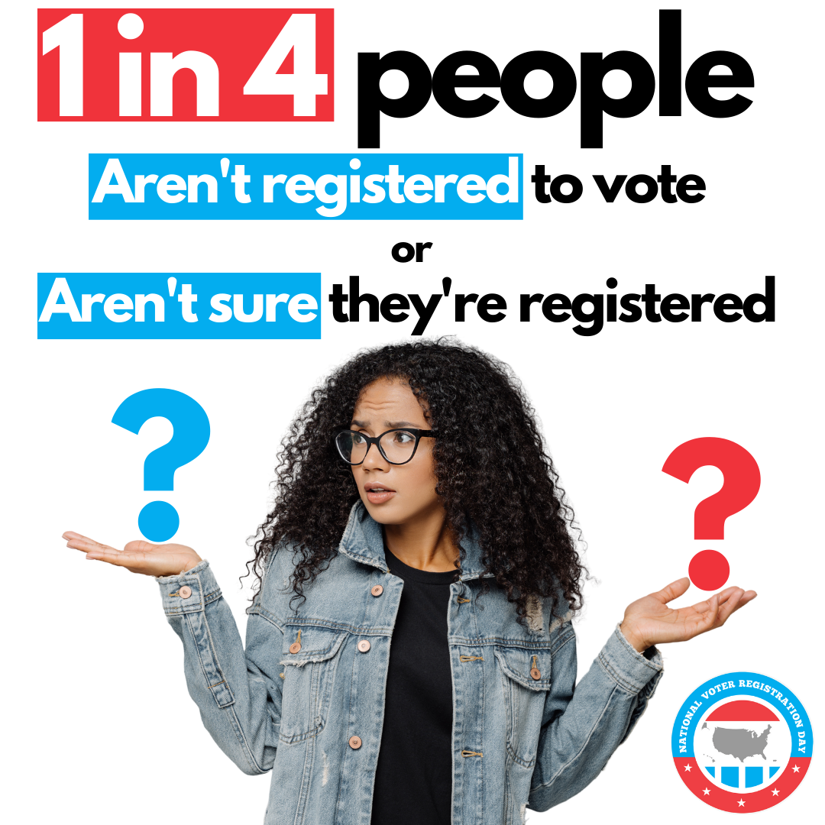
Why Celebrate National Voter Registration Day?
As many as 1 in 4 eligible Americans are NOT registered to vote
This figure is EVEN higher for youth and communities of color
Millions of Americans miss elections each year due to registration problems or missing deadlines
Our democracy works best when more of us participate!
YOU have unique and trusted relationships in your community, and YOU can help change this!

Slide 4
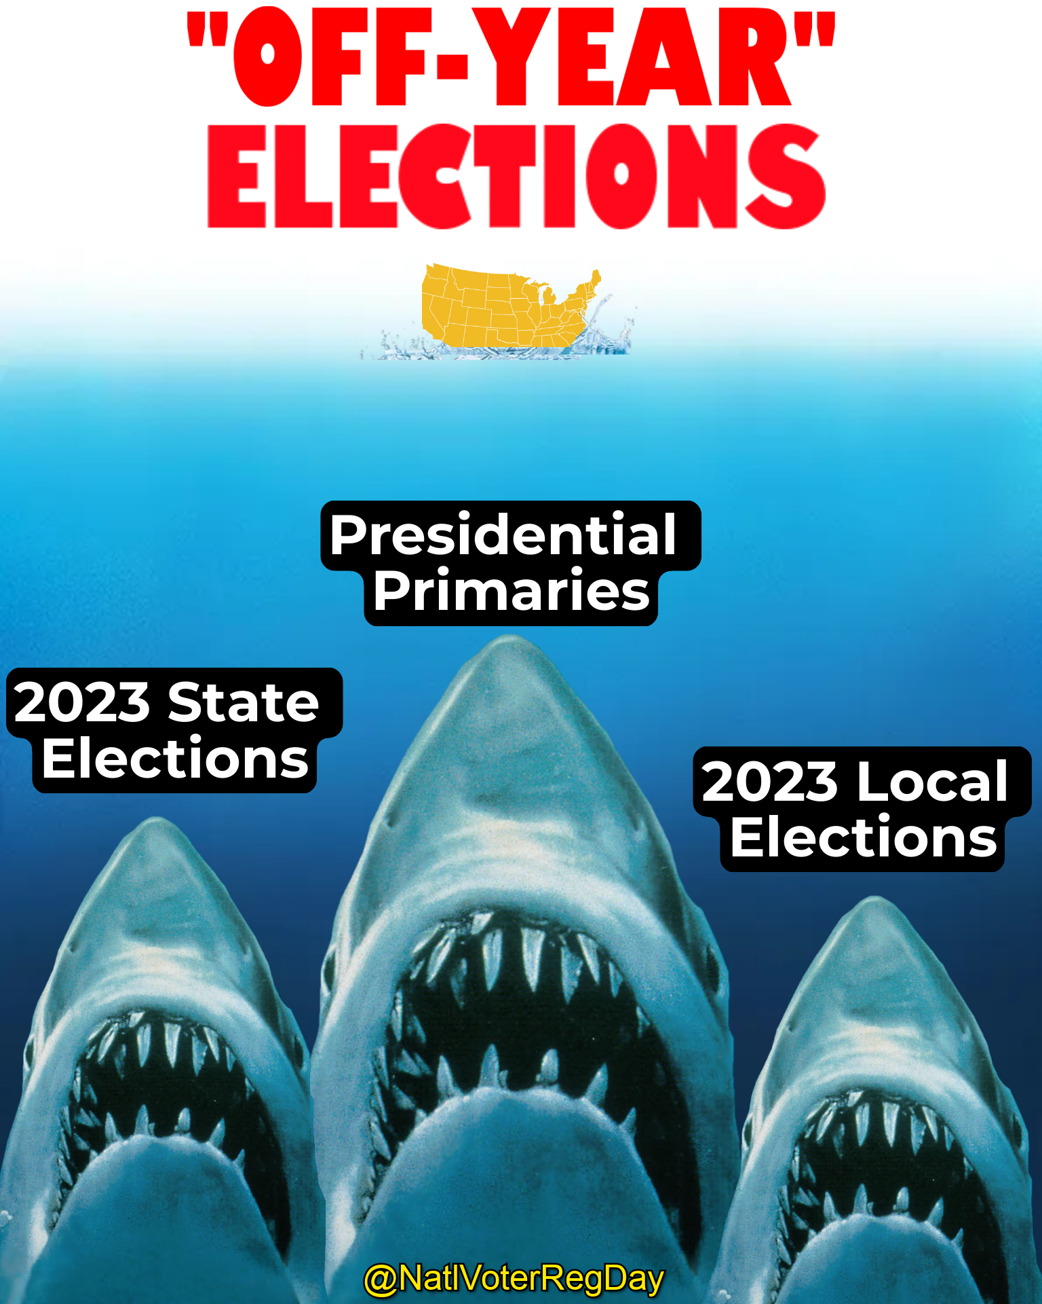
And We Have Big Goals for 2023
Register more than 300,000 people to vote on September 19
Engage more than 4,000 community partners (like you)
Get people ready for their local and state elections

Slide 5
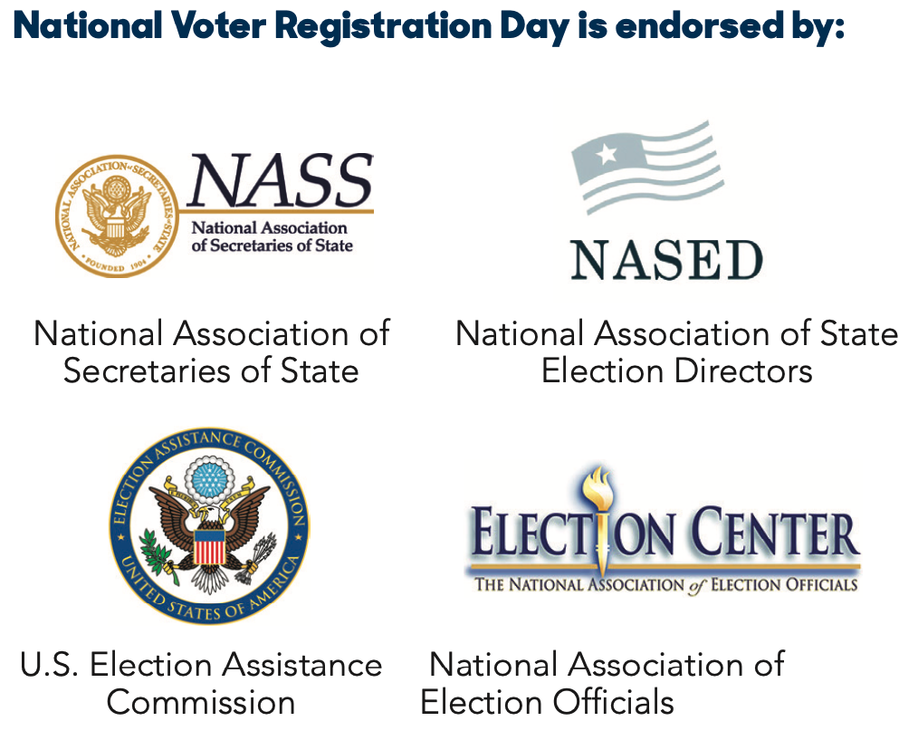
You Are a Part of Something BIG
Supporting hundreds of thousand of voters nationwide as they …
Update their registration or register to vote for the first time
Learn more about upcoming elections
Celebrate a civic holiday!
Joined by thousands of community partners across the country!

Slide 6
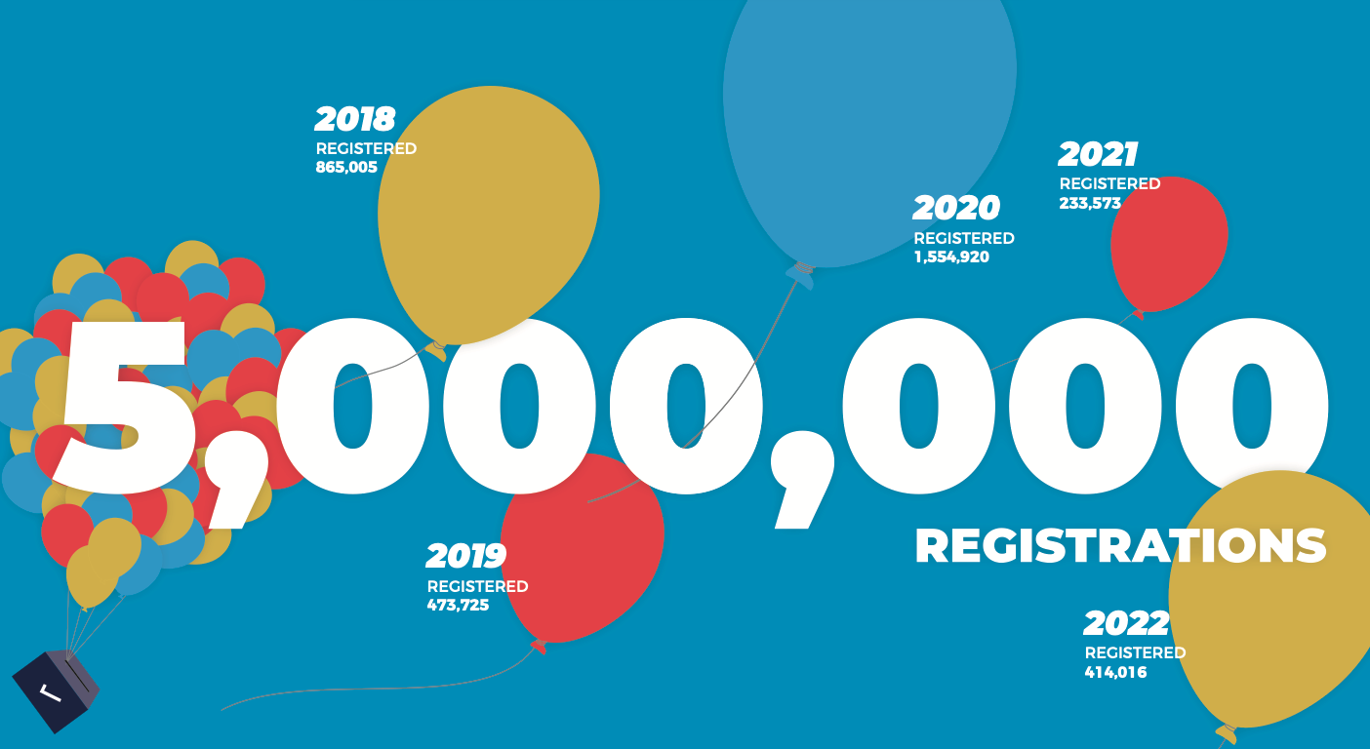
Making an Impact: Every Registration Matters
Since 2012, National Voter Registration Day has helped more than 5 million people register to vote for the first time or update their registration.

Slide 7
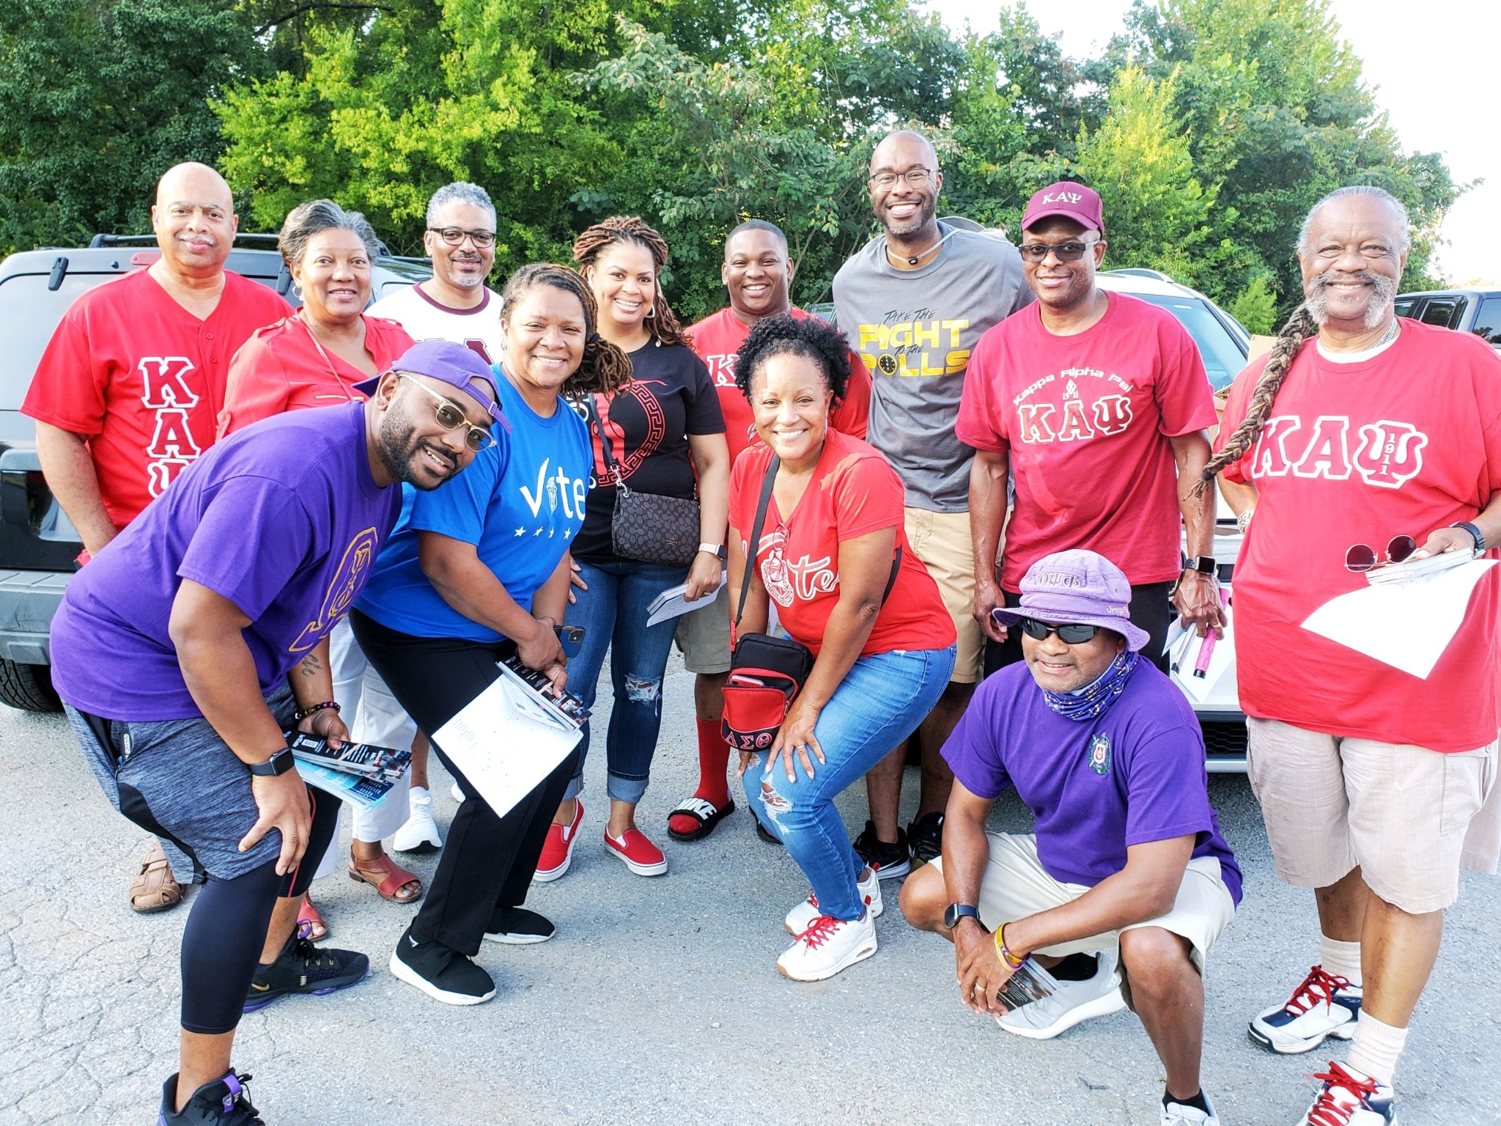
Why join become a partner?
National Voter Registration Day is a partner-driven effort!
Every year, thousands of partners of all stripes and sizes participate: nonprofits, campus and youth groups, high schools, libraries, election offices, companies, co-ops, digital platforms, media outlets, and more
Partners organize community events, post on social media, conduct employee outreach, hold online events, and leverage their network and reach to register voters

Slide 8
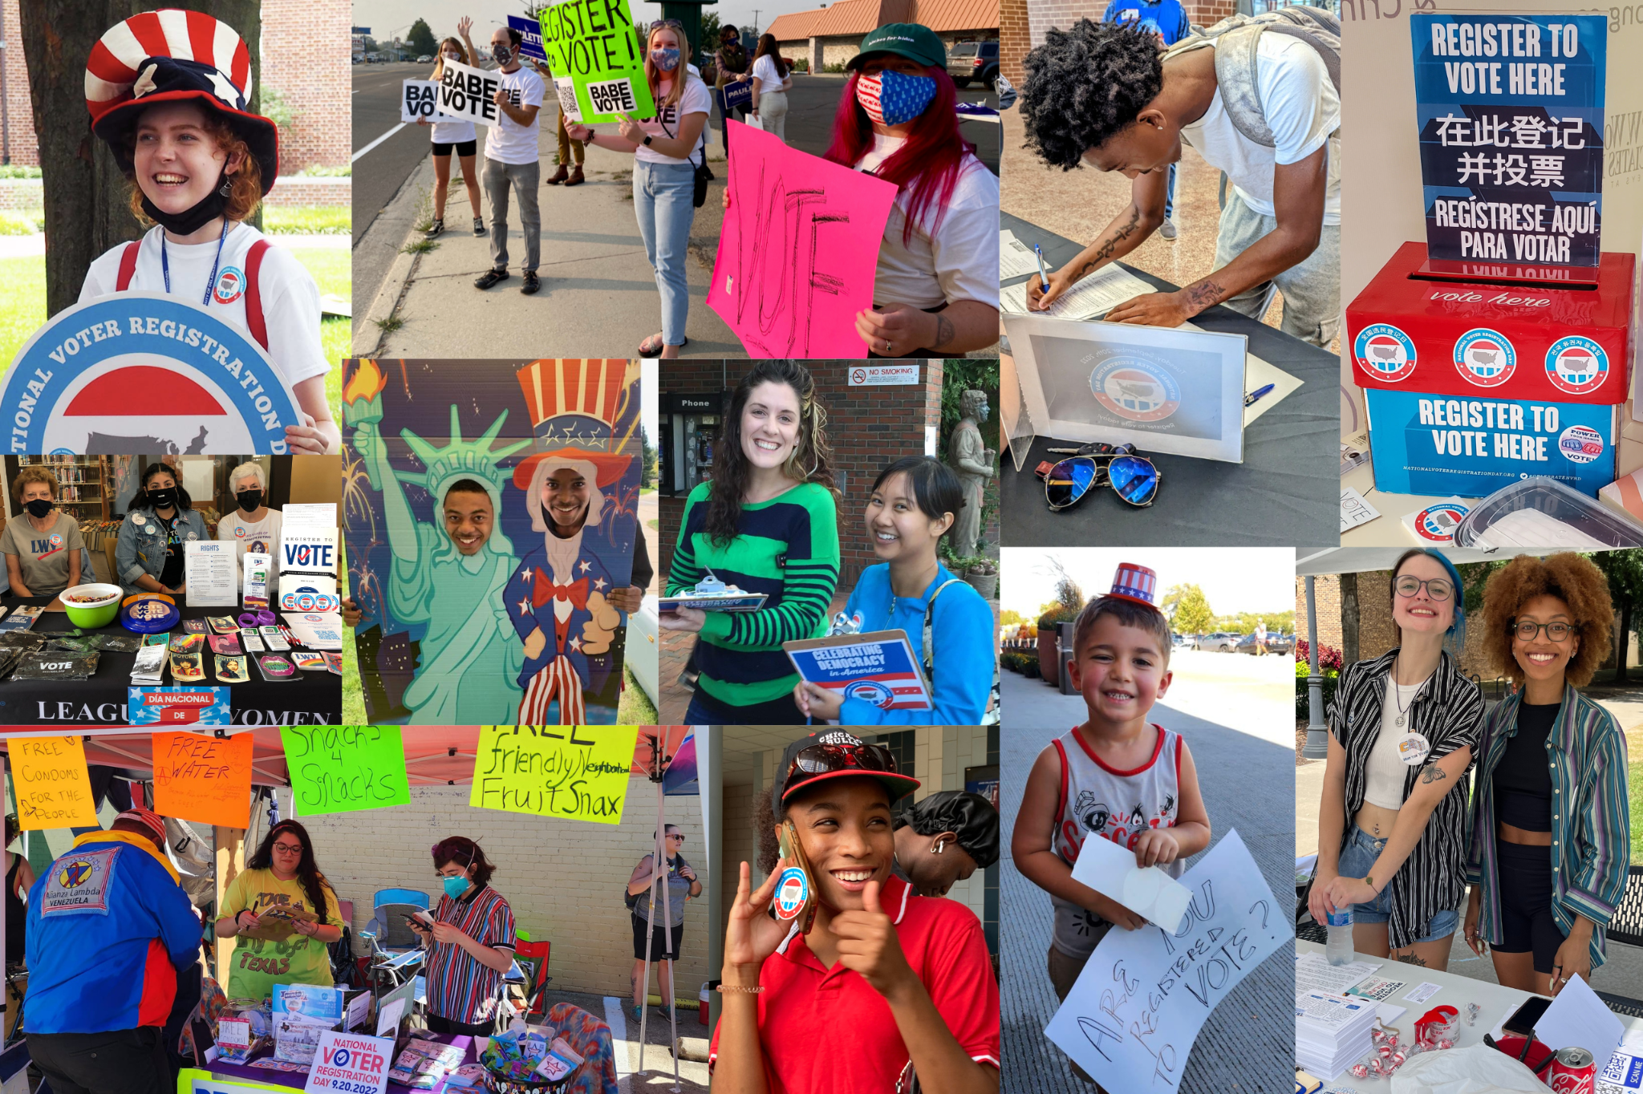
Community Partner Expectations
Nonpartisan
Inclusive
Aware of your state’s voter registration laws
Non-transactional
Fun!

Slide 9
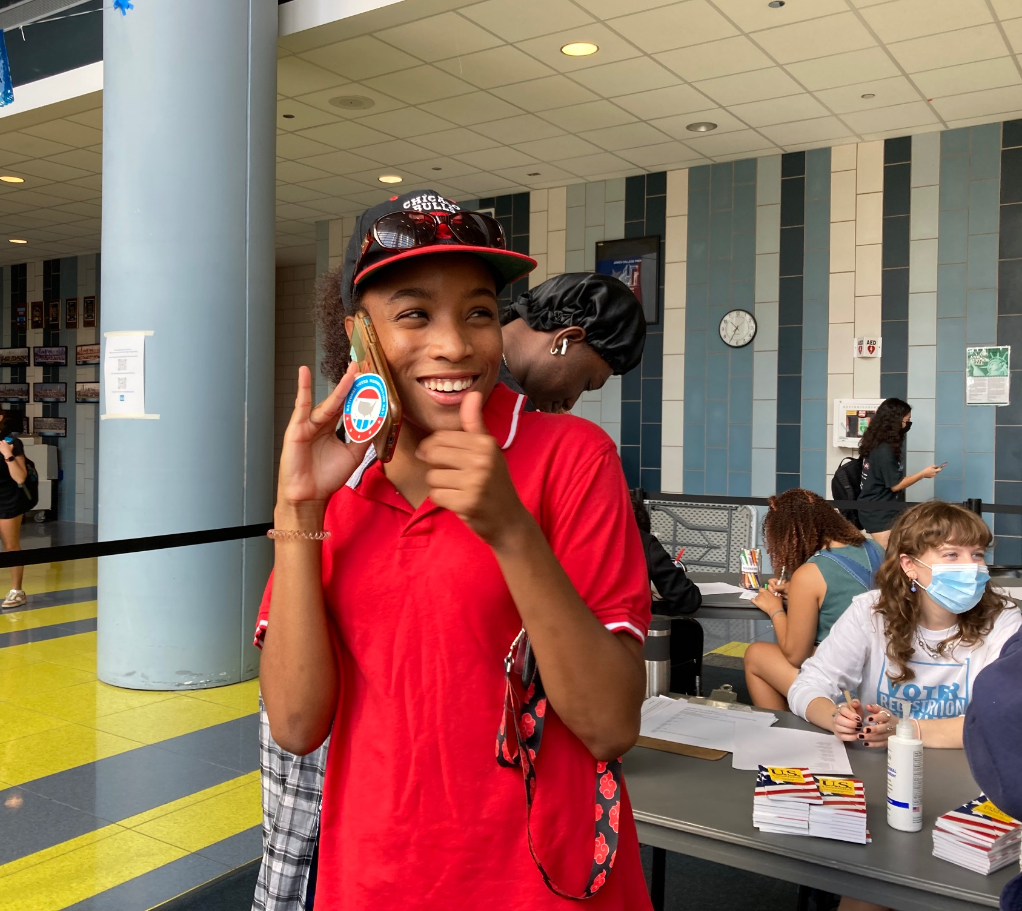
How we support you
We support partners of ALL experience levels to succeed. 30% of partners each year are completely NEW to voter registration!
Free swag, including branded posters and stickers, and QR code registration placards
Communications and social media support
Live training webinars
State-specific resources
Organizer guides
Publicly uplifting your work

Slide 10
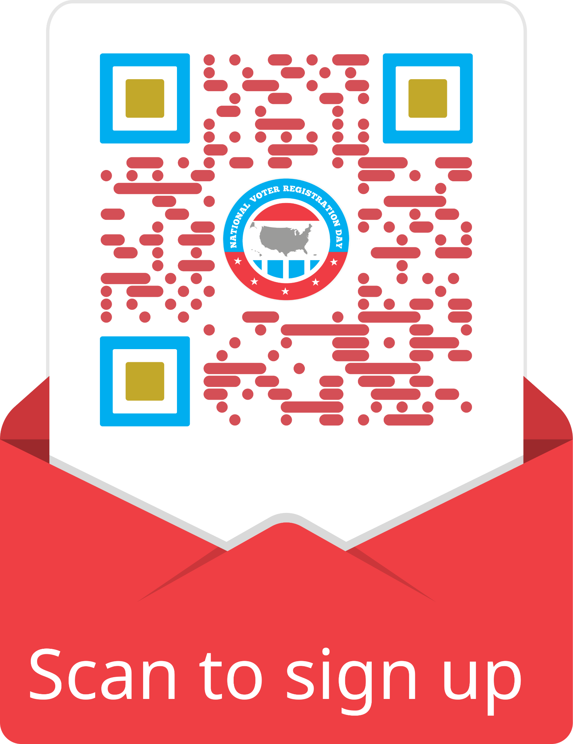
Become a 2023 partner TODAY!
Partners agree to remain nonpartisan in all outreach associated with the holiday
With YOUR help, we hope to register hundreds of thousands of voters in time for the 2024 primaries!
Follow along on social: @NatlVoterRegDay on all platforms
Scan QR code to sign up in just 5 minutes or less!

